Slide 1

Chess Bot Detector
This presentation summarizes our project. We developed a system to detect chess bots. Our project promotes fair play in online chess. The system uses machine learning techniques. It analyzes game statistics for bot identification. We built a user-friendly web interface. The project helps maintain integrity.

Slide 2


Introduction:
The rise of online chess has led to bot usage. Bots provide unfair advantages. Manual detection is inefficient. Existing systems lack real-time analysis. Our project offers a match-level bot detection system. It promotes transparency and fair play. We used ML to detect Bot usage in an online Chess game.

Slide 3

Basic Concepts:
Machine Learning: Models distinguish human from bot behavior. They analyze patterns in gameplay data. Features for Detection: Avg move time, turns, game duration are key indicators. Bots play near-perfect games.
Our system relies on key concepts. Machine learning identifies patterns in game play. Flask creates a backend server. Front end is based on HTML, CSS, and JS. We deploy on Render.

Slide 4

Problem Statement:
To develop a lightweight system. It detects bot usage in chess games. The detection is based on match statistics. It is accessible via a web interface.
The goal is a user-friendly, accessible system. Users input game data for instant analysis. The system should support real-time predictions. Web accessibility is crucial. The project emphasizes fair gaming.

Slide 5
Project Planning:
Requirement Gathering: Identify the need for the system.
Feature Selection: Choose crucial game features.
Model Development: Build a machine learning model.
Web Development: Create a user-friendly web app.
Testing: Perform rigorous testing for accuracy.
Deployment: Deploy the system online.
Project development followed these steps. We gathered requirements and selected key features. A machine learning model was developed. A web application was built. Testing was conducted. Finally, we deployed the system.

Slide 6
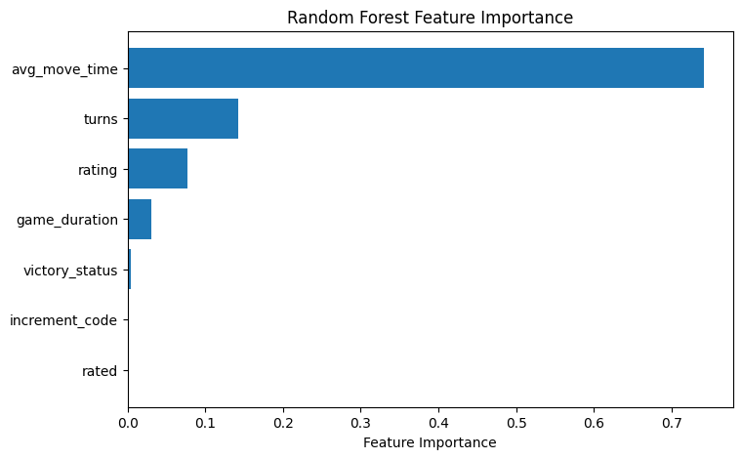
Implementation:
"From the initial stage of data collection to the final step including model selection, every aspect has been carefully considered. The selection of this particular model was based on its ability to accurately predict results while effectively utilizing feature importance, which plays a crucial role in the decision-making process."
Feature Importance:
The Random Forest Classifier works based on the principle of feature importance. It builds multiple decision trees during training, where each tree splits the data based on features that minimize a certain impurity measure — usually Gini impurity or entropy (used in information gain).
At each node in a tree, the algorithm selects the best feature and threshold to split the data into two branches, aiming to reduce impurity as much as possible. The branch with the lower impurity is preferred during splits. This process continues recursively until a stopping condition is met (like max depth, minimum samples per leaf, etc.).
Feature importance is then derived by measuring how much each feature contributed to reducing impurity across all trees in the forest.

Slide 7
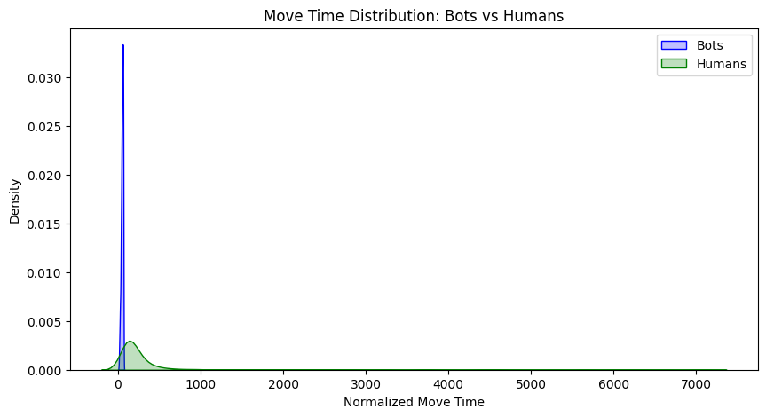
Result Analysis:
The model achieved 87% average accuracy. It distinguishes human and bot gameplay. There's a low false-positive rate. It helps avoid misclassifying skilled players as bots. Feature Importance helps determine results.
# Using (KDE) Kernel Density Estimation plot comparing the distribution of normalized move times for bots (blue) and humans (green).
The plot visually highlights a negative correlation between player rating and move time, reinforcing that move time is a strong feature for distinguishing bots from humans. Bots often exhibit consistent or unusually fast move patterns, making them stand out. It also supports your rule-based logic—like using move time thresholds for shorter games—and can help refine those thresholds. Additionally, the graph aids in spotting outliers, such as high-rated players with long move times, which may signal anomalies or misclassifications. Overall, it provides clear visual justification for using rating and normalized move time in your model.

Slide 8
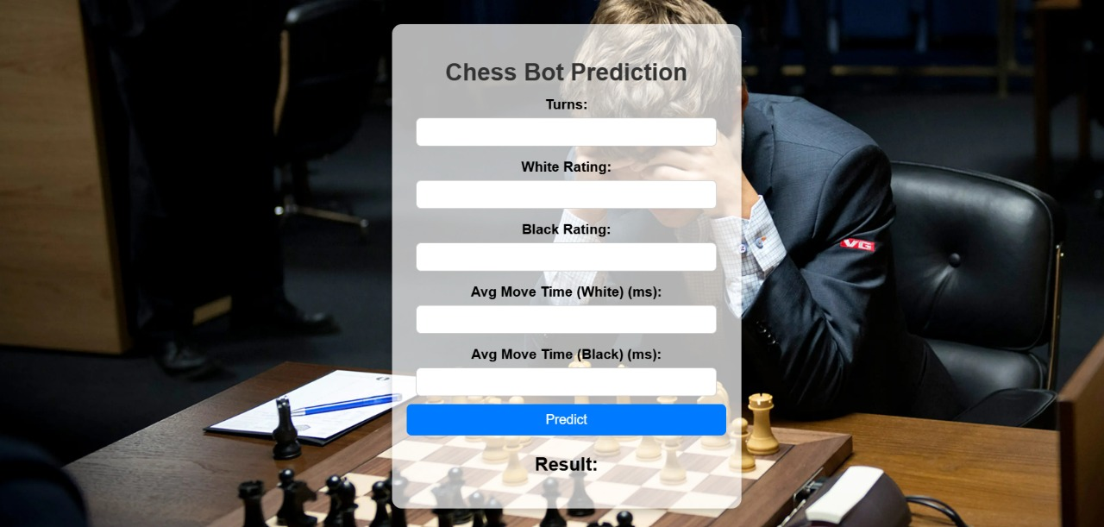
Testing and QA:
. Code Review: Peer-reviewed among team members.
. Testing with Real Data: Tested known bot and human games.
. Model Validation: Multiple performance metrics.
The functionality of the model has been thoroughly tested, not only within the development environment but also on the deployed web platform. This ensures that users experience a seamless and user-friendly interface, free from unnecessary complexity, while also benefiting from fast and accurate predictions.

Slide 9
Standards Adopted:
IEEE 830: Software Requirements Specification (SRS).
IEEE 1016: Software Design Documentation.
UML: Use Case and Class Diagrams.
PEP8: Python Code Style Guide.
Standards were adopted throughout the project to ensure efficiency, accuracy, and maintainability. Industry-standard design principles and coding guidelines were strictly followed to promote clean, modular, and scalable code development. Various testing standards, including unit testing, integration testing, and performance testing, were applied to validate the model’s functionality and reliability.
Adherence to these standards not only enhanced the overall quality of the project but also ensured a seamless user experience, faster response times, and higher accuracy in predictions.

Slide 10
Conclusion and Future Scope:
Larger Datasets from multiple chess platforms.
Advanced Features: Engine move depth.
Deep Learning: Recurrent neural networks.
Mobile App Support.
The project achieved its core objective. It offers a scalable solution for gaming integrity. The system detected bots with good accuracy. Future developments aim to introduce features such as opening analysis and pattern recognition during gameplay by utilizing move history to evaluate consistency in a player's performance. These improvements are expected to contribute significantly towards achieving higher prediction accuracy and a more personalized user experience.

